Slide 1
CID 17-2015
* Harrison County
* US 62 (Oddville Pike)
* JPC Pavement with Grade and Drain

Slide 2
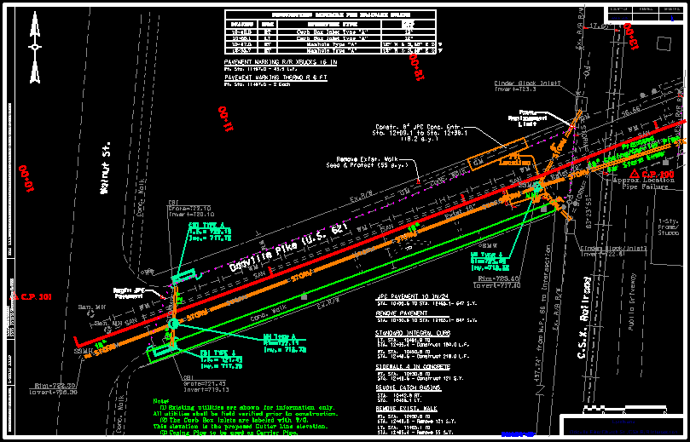

Slide 3
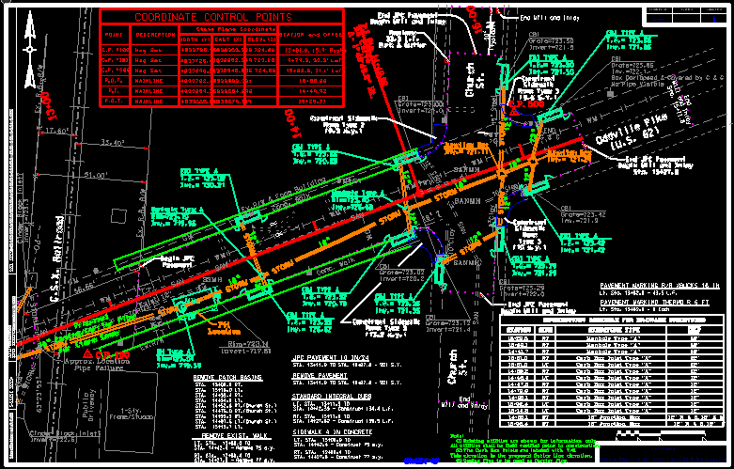

Slide 4
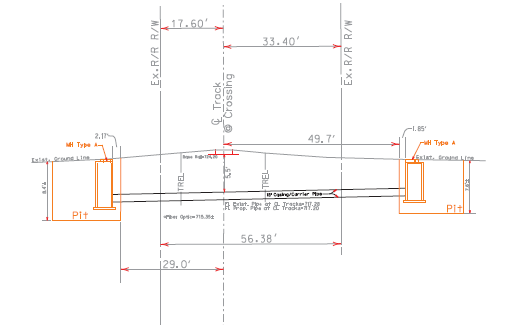

Slide 5
PIPE RAMMING VS. JACK & BORE
* Permitting – Railroad was interested in Ramming vs. Traditional Jack & Bore

Slide 6
…going the ramming route
* 90 L.F. of 18” Steel Casing Pipe
* Inside of Pipe to be Lined after Install
* Unit Price = $788.00/L.F.

Slide 7
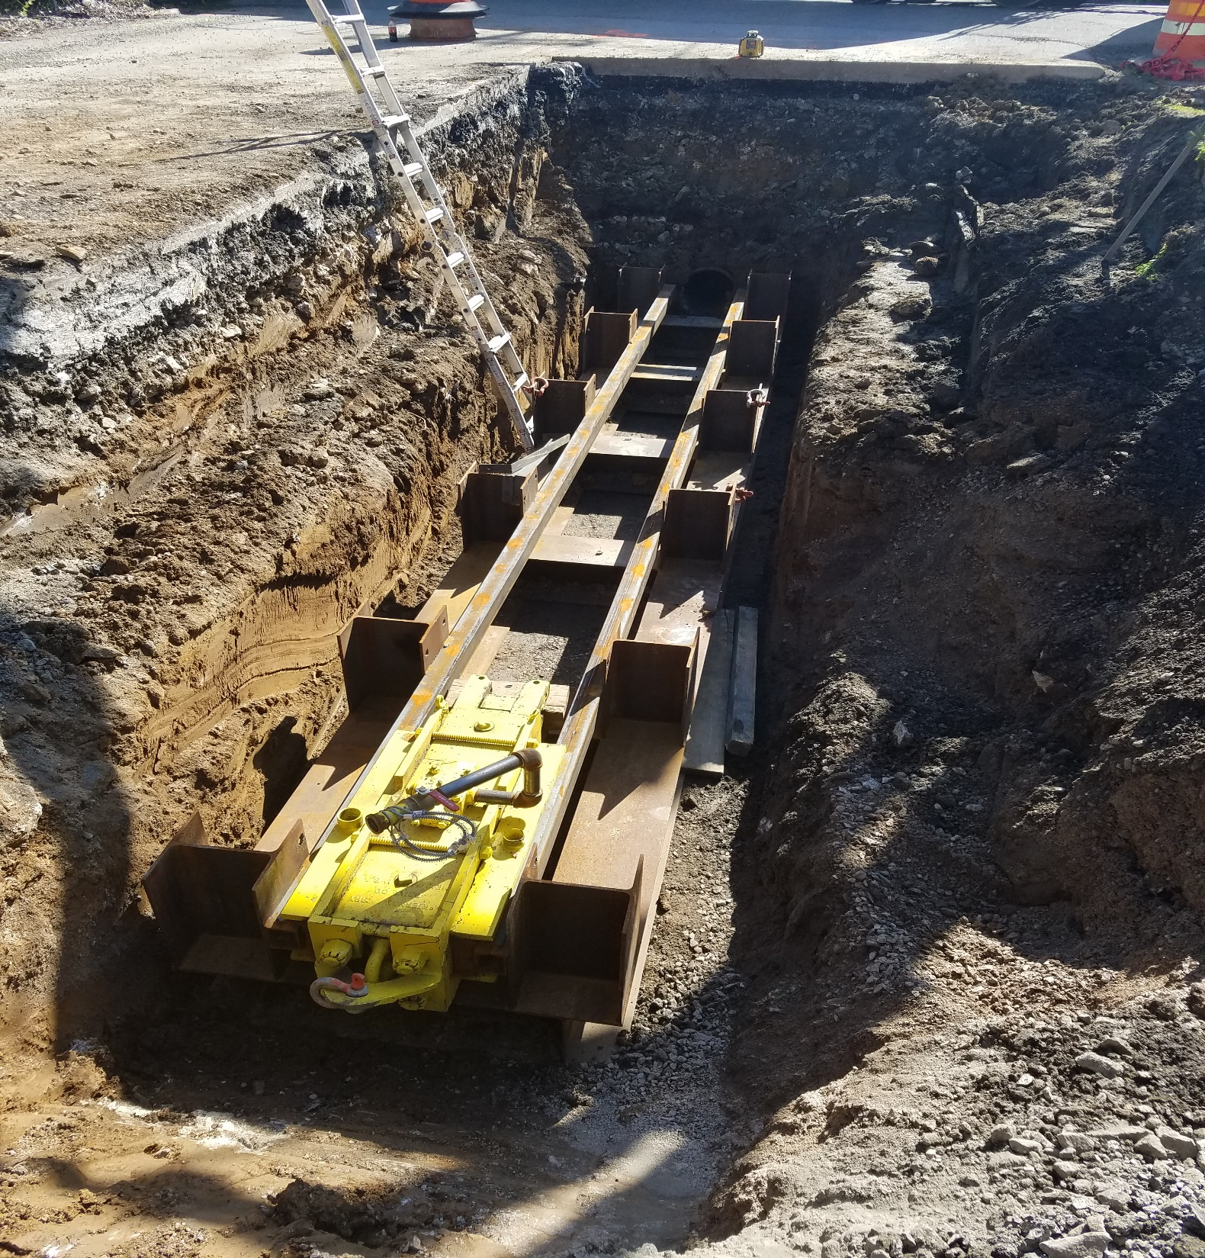

Slide 8
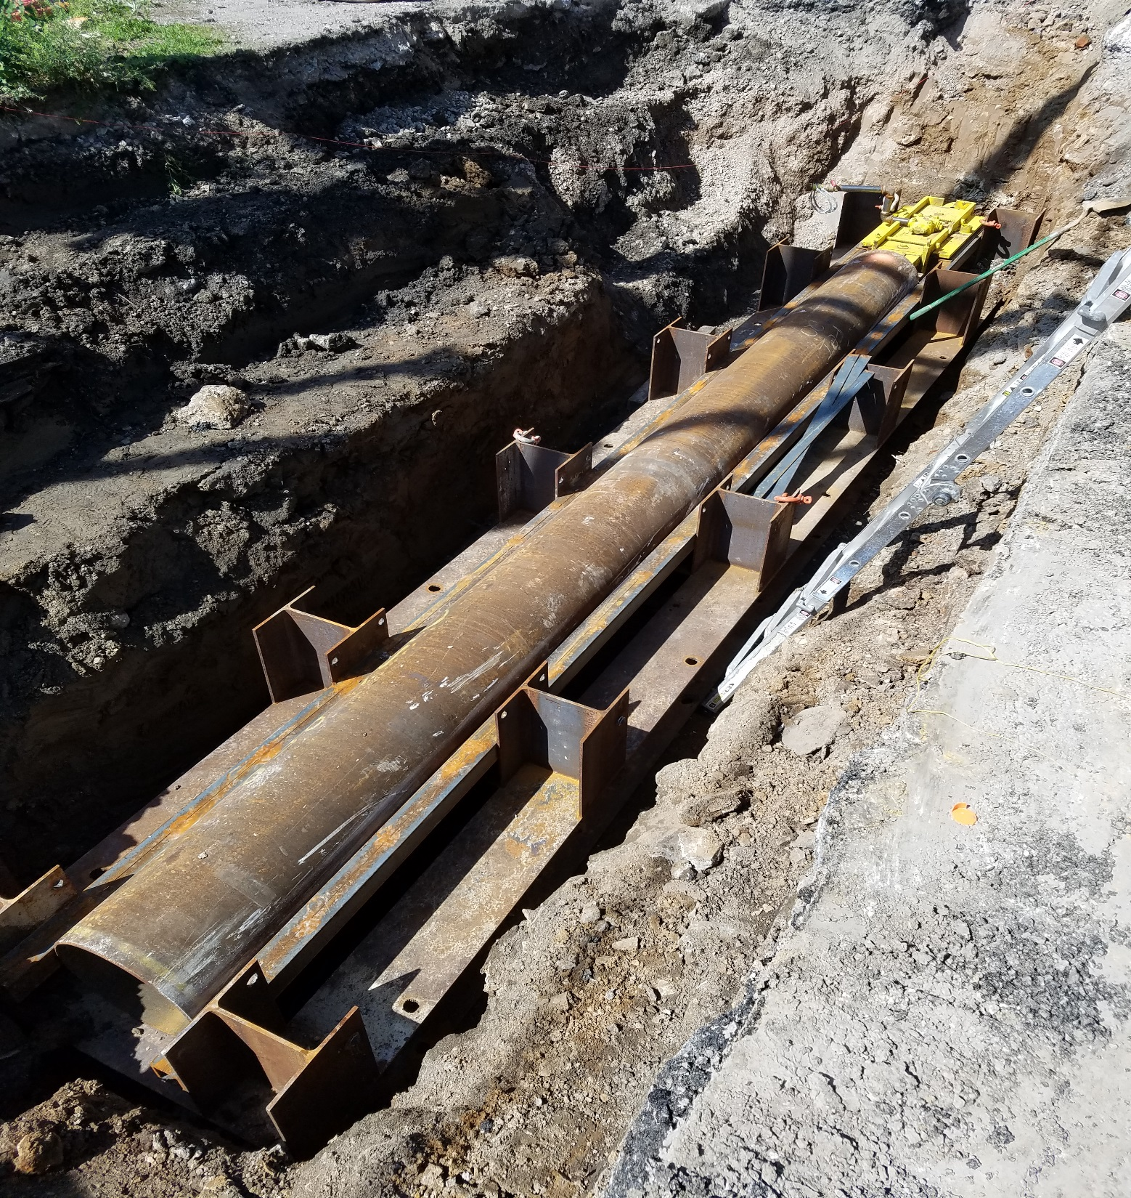

Slide 10
McKiernan-Terry #5 hammer
* 1,500 Lbs in Weight
* Produced in 1921
* Vertical Pile Driving (Sandy Soil)
* 15’ Depth – 4”x12” Wooden Pile
* 20’ Depth – 12” Wide Steel Pile

Slide 11
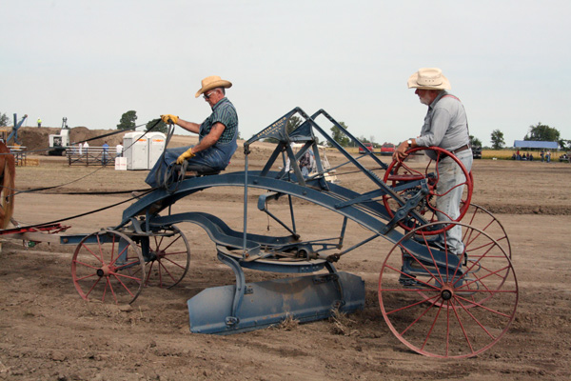

Slide 12
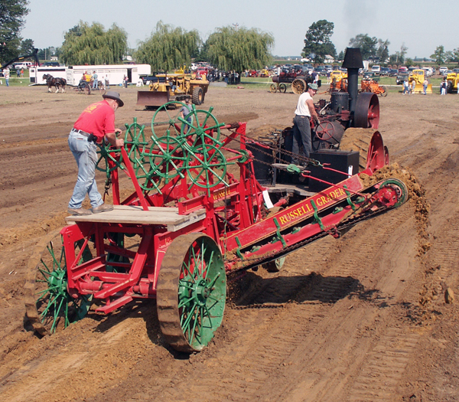

Slide 14
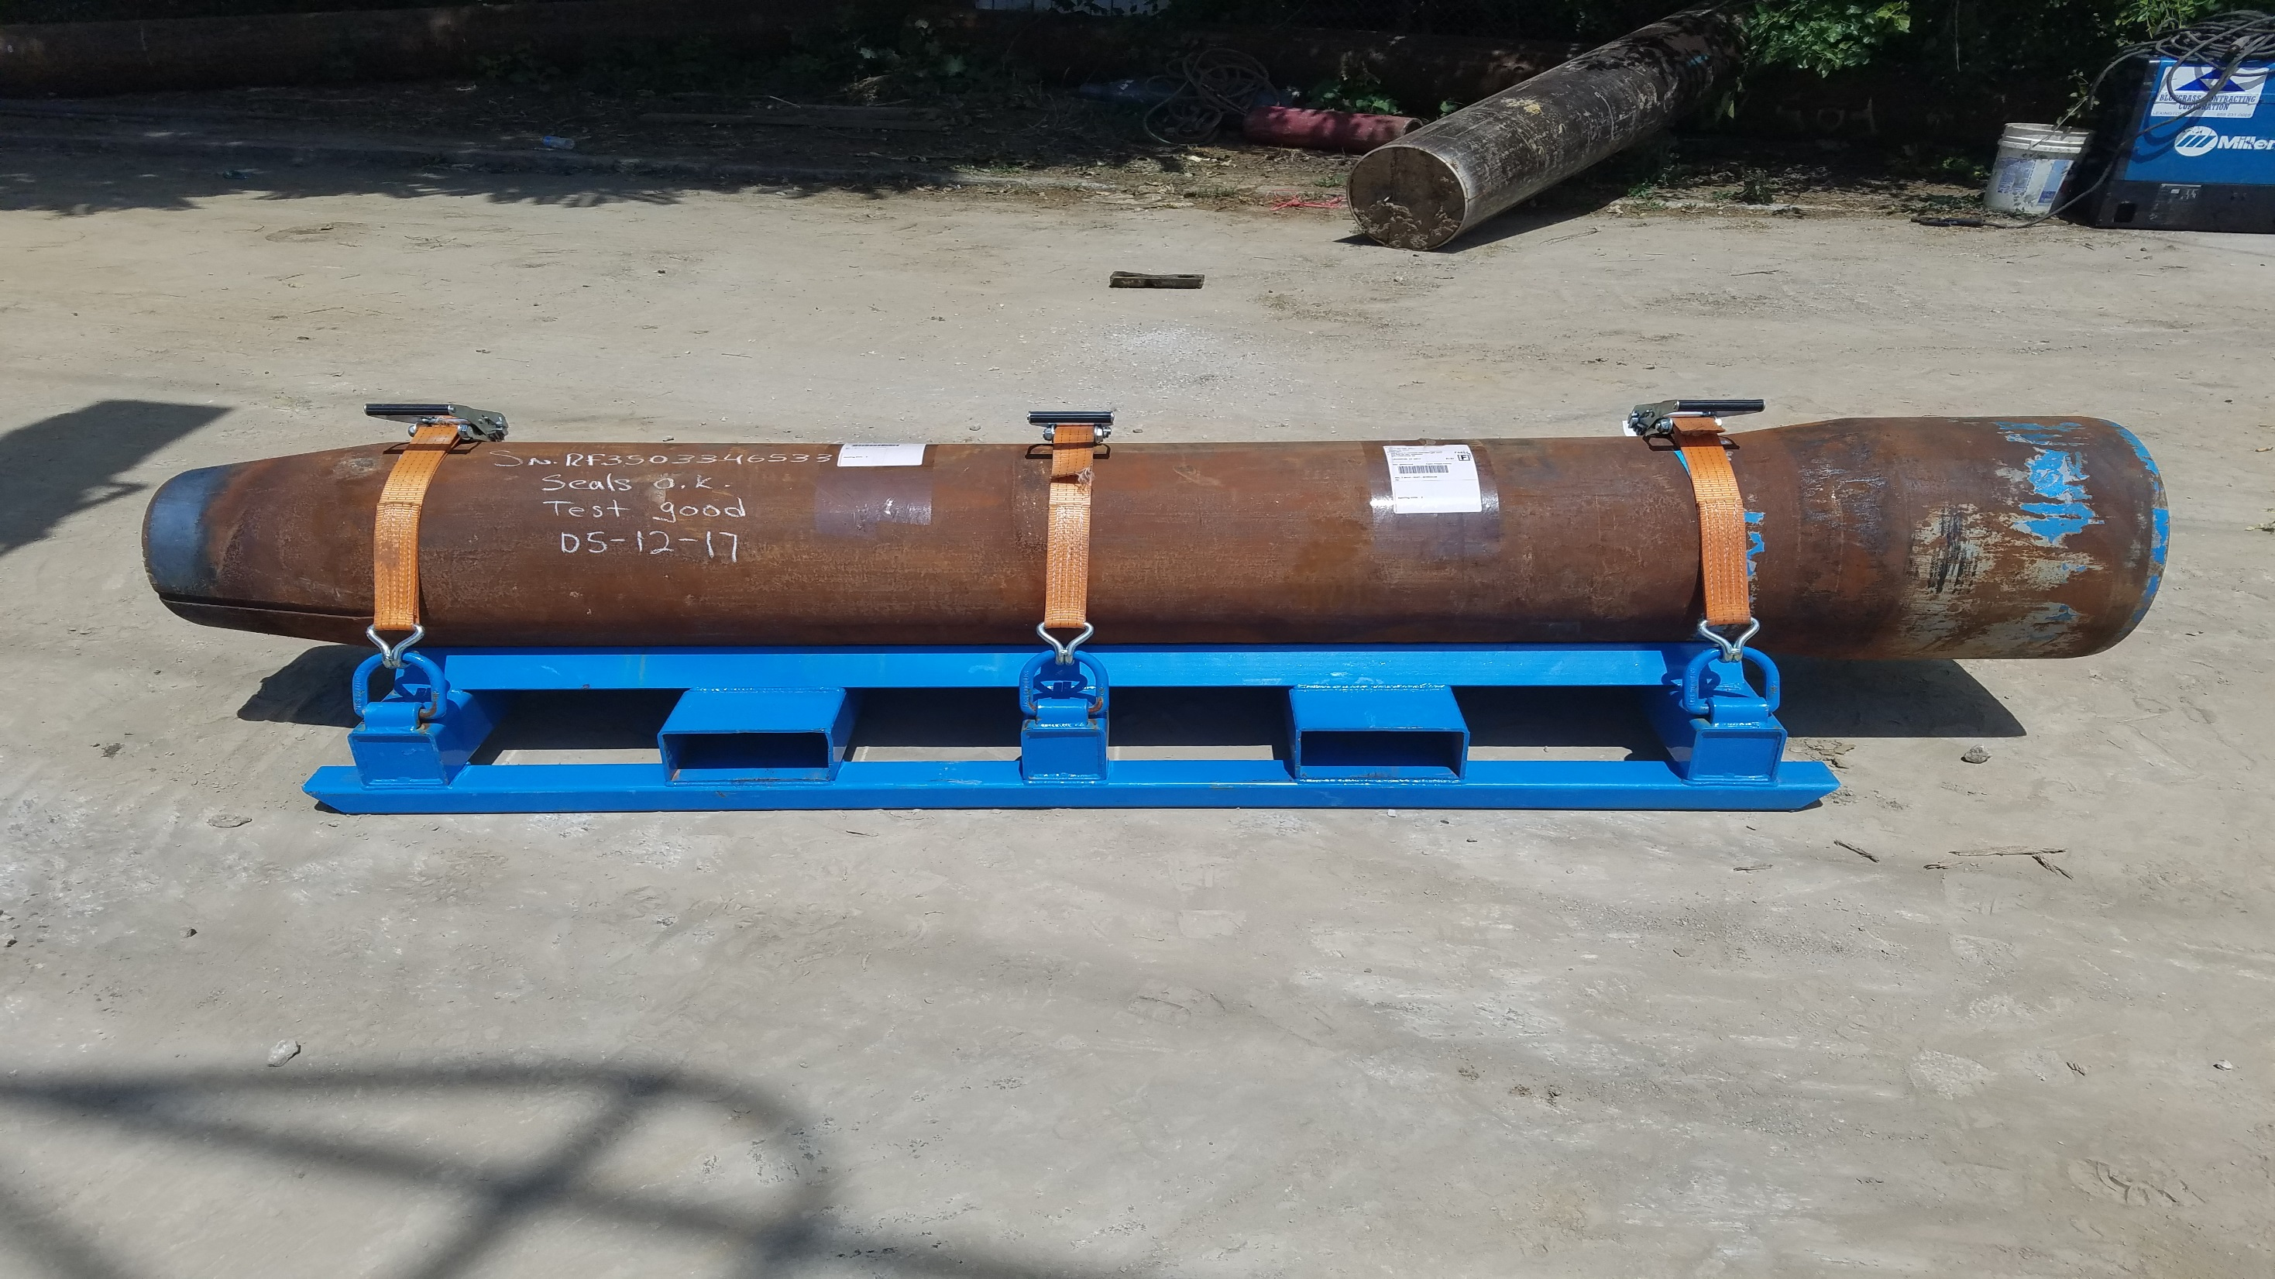

Slide 15
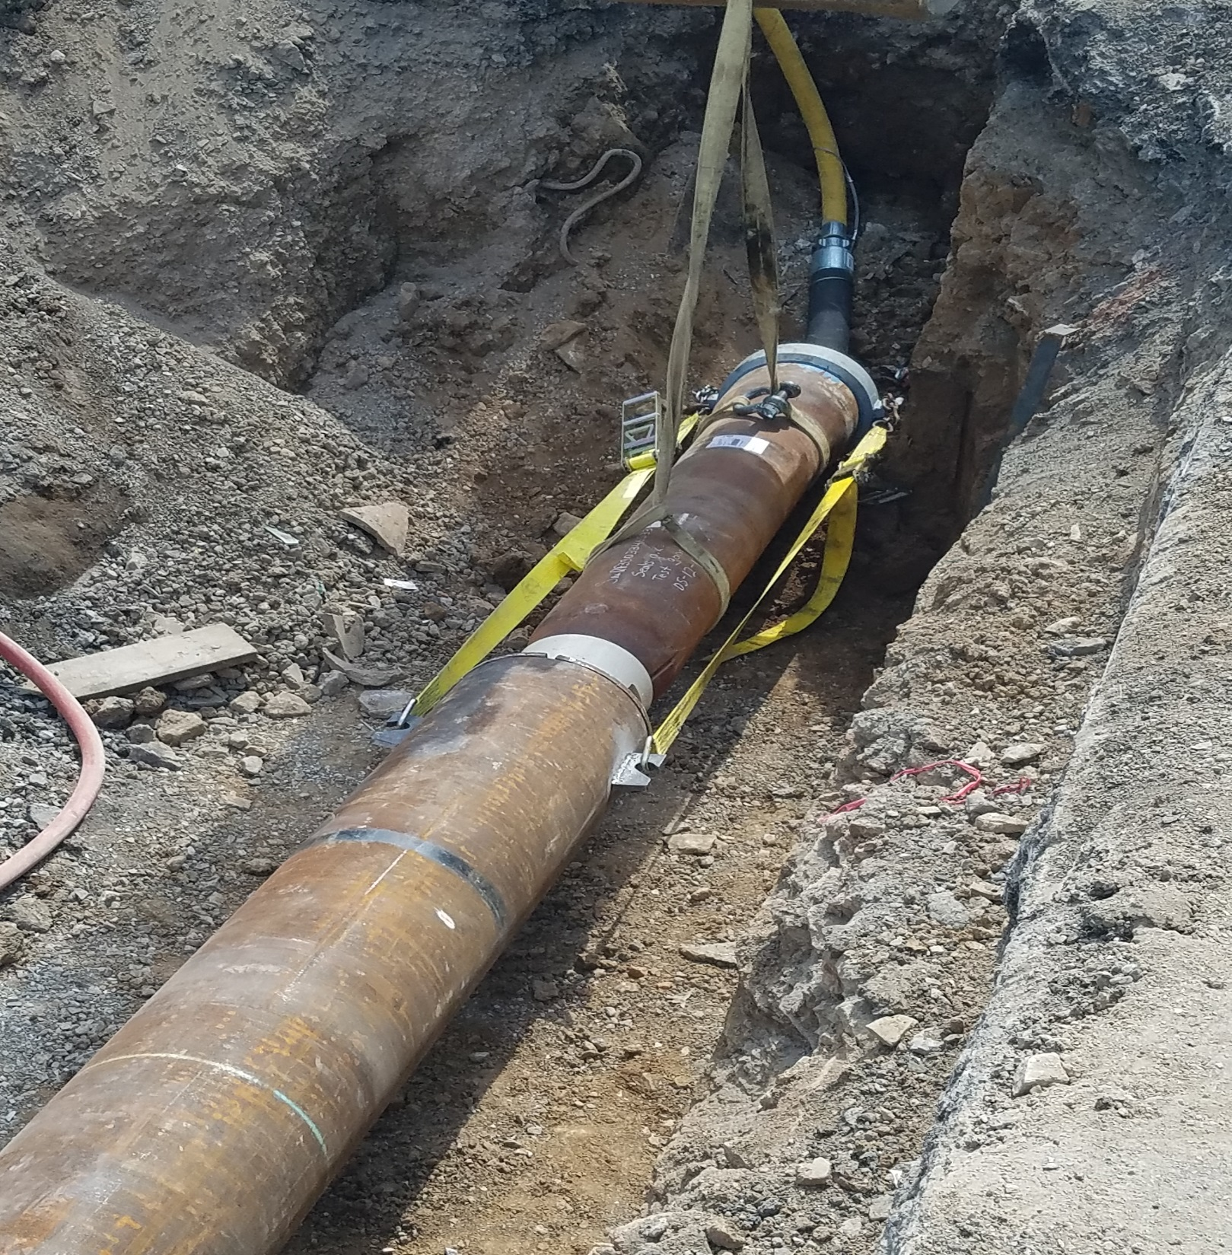

Slide 17
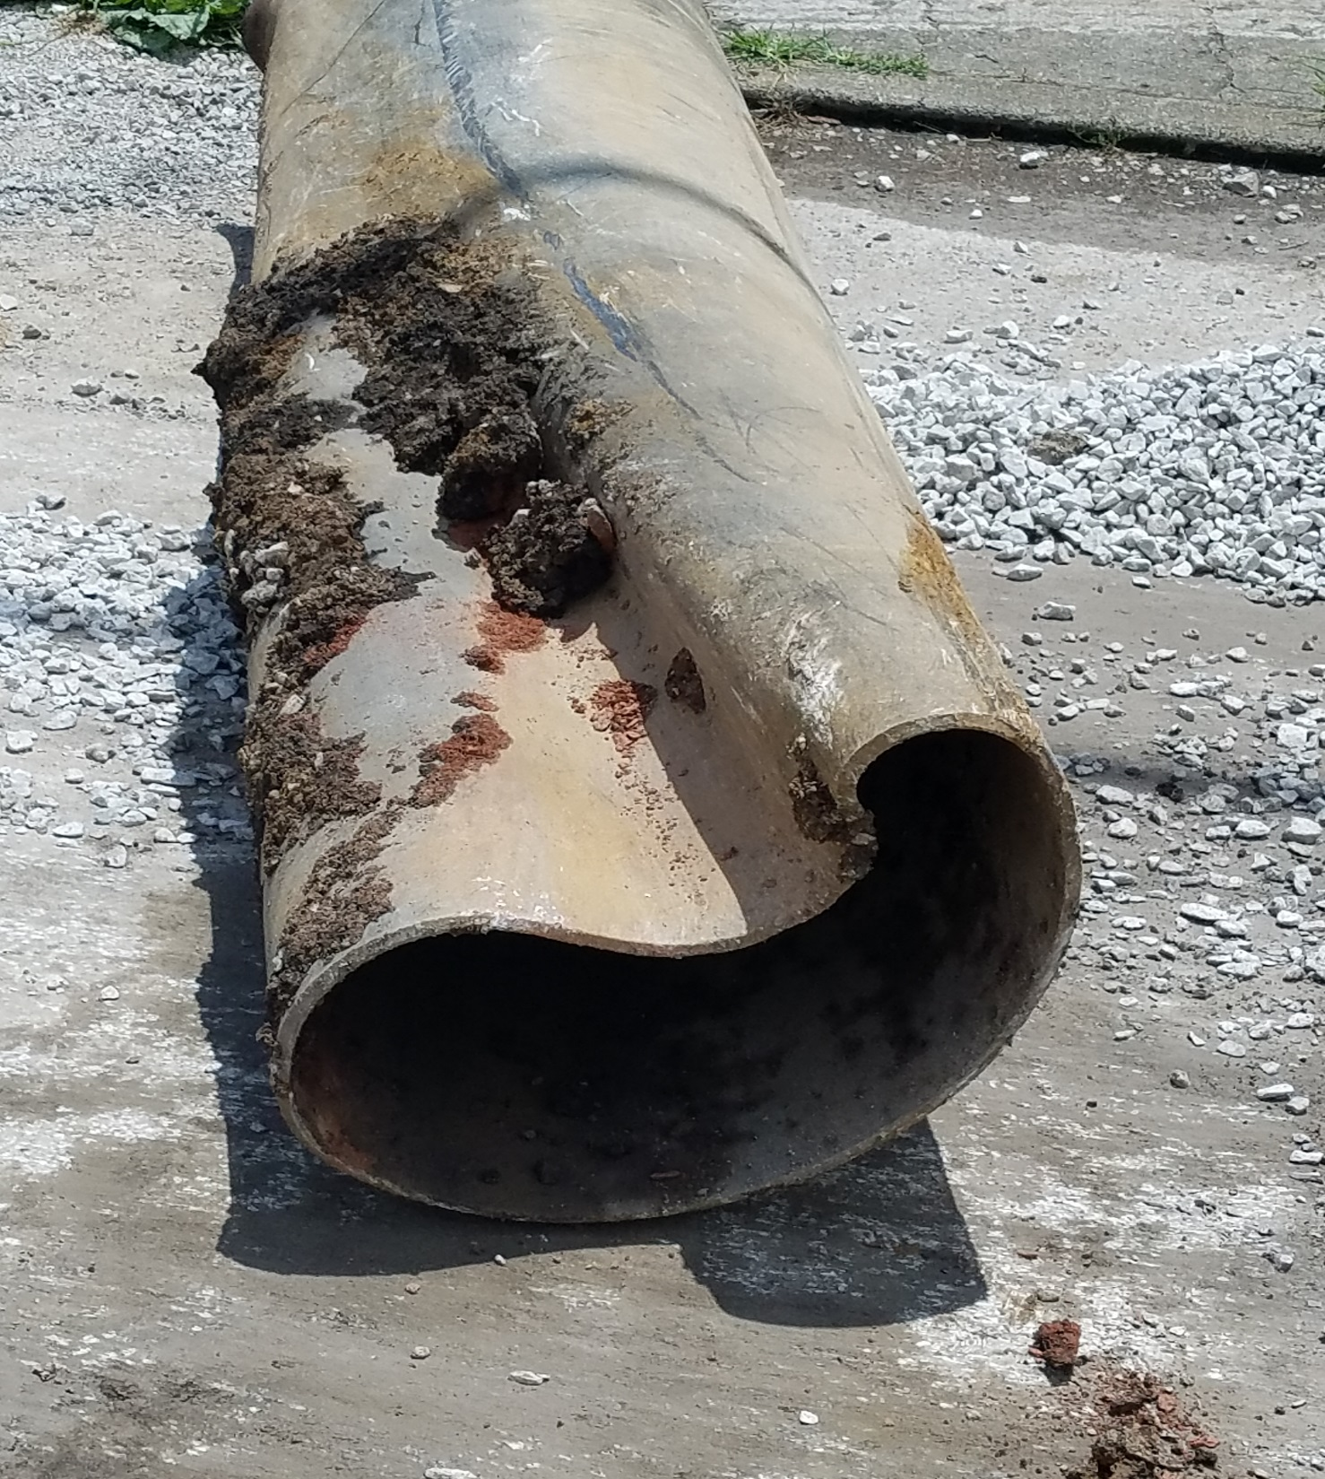

Slide 18
Lessons learned…

Slide 19
…going the ramming route
* Situationally Made a Good Decision

Slide 20
* Utilized a very simple but effective project note

Slide 21
Consider specifying a cutting shoe …

Slide 22
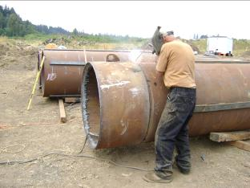

Slide 23
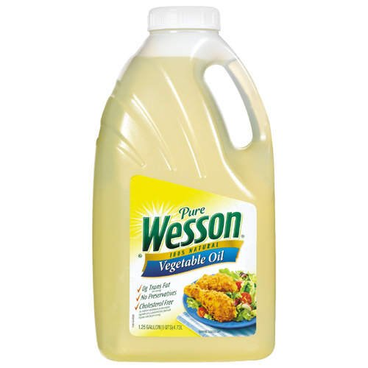

…have the right tools for the job
Good
Better

Slide 24
Questions:
Jerry F. Keith, SE
KYTC District 6
jerry.keith@ky.gov

